Slide 1
CEIS114 FINAL PROJECT Traffic controller
Lakisha Snipe

Slide 2
Table of contents
1. Introduction
2. Gathering the components to build the traffic controller
3. Creating the Traffic Controller
4. Creating a multiple traffic light controller
5. Creating a multiple traffic light controller with a cross walk
6. Creating a multiple traffic light controller with a cross walk and an emergency buzzer
7. Creating a Multiple Traffic Light Controller with a Cross Walk and an Emergency Buzzer with SMART sensor(option 2)
8. Student feed back and reflection.
9. Conclusion, challenges and career skill obtained

Slide 3
Introduction
In this class we learned concepts of electronics, particularly digital electronics.
Many IOT devices comprised of various sensors and electronic components are the integral parts of IOT devices. We were introduced to basic electronic components, transducers, sensors, and actuators along with packaging and testing used in IOT devices.​ ​.

Slide 4
1. Gathering the components to build the traffic controller

Slide 5
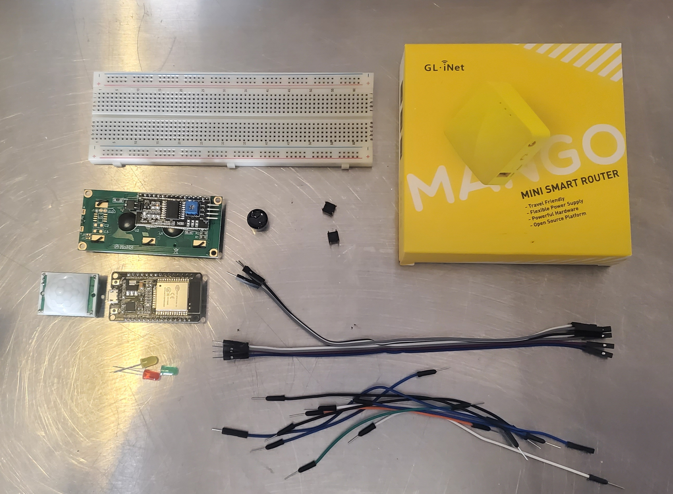
Inventory (Picture)
Breadboards
Mini Router
Push Buttons
ESP 32 Board
Colored LEDs: Red, Yellow, Green, and Blue
220 Ohm Resistors (optional)
Wires
Breadboard(s)
LCD Unit with I2C Adapter
Active Buzzer
Mini Router
Push Button(s)
PIR Motion Sensor
LCD UNIT
ESP 32 Board
PIR Motion Sensor
Active Buzzer
Colored LED’s
Wires

Slide 6
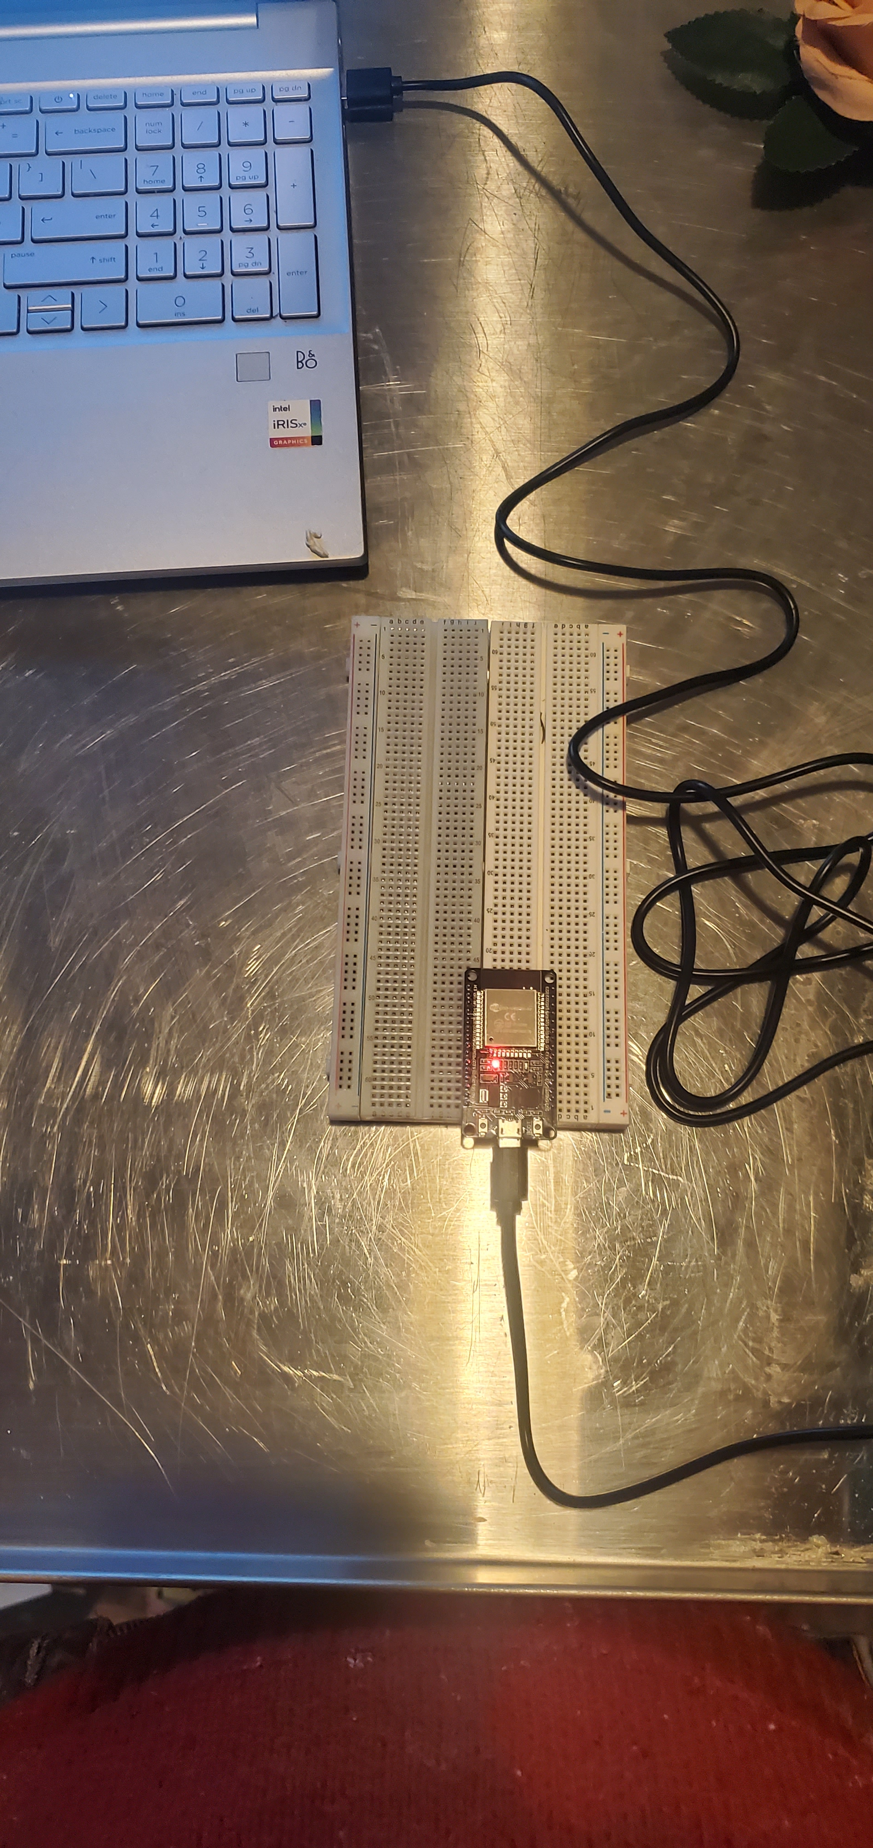
ESP32 (Picture)
Microcontroller mounted and powered ON

Slide 7
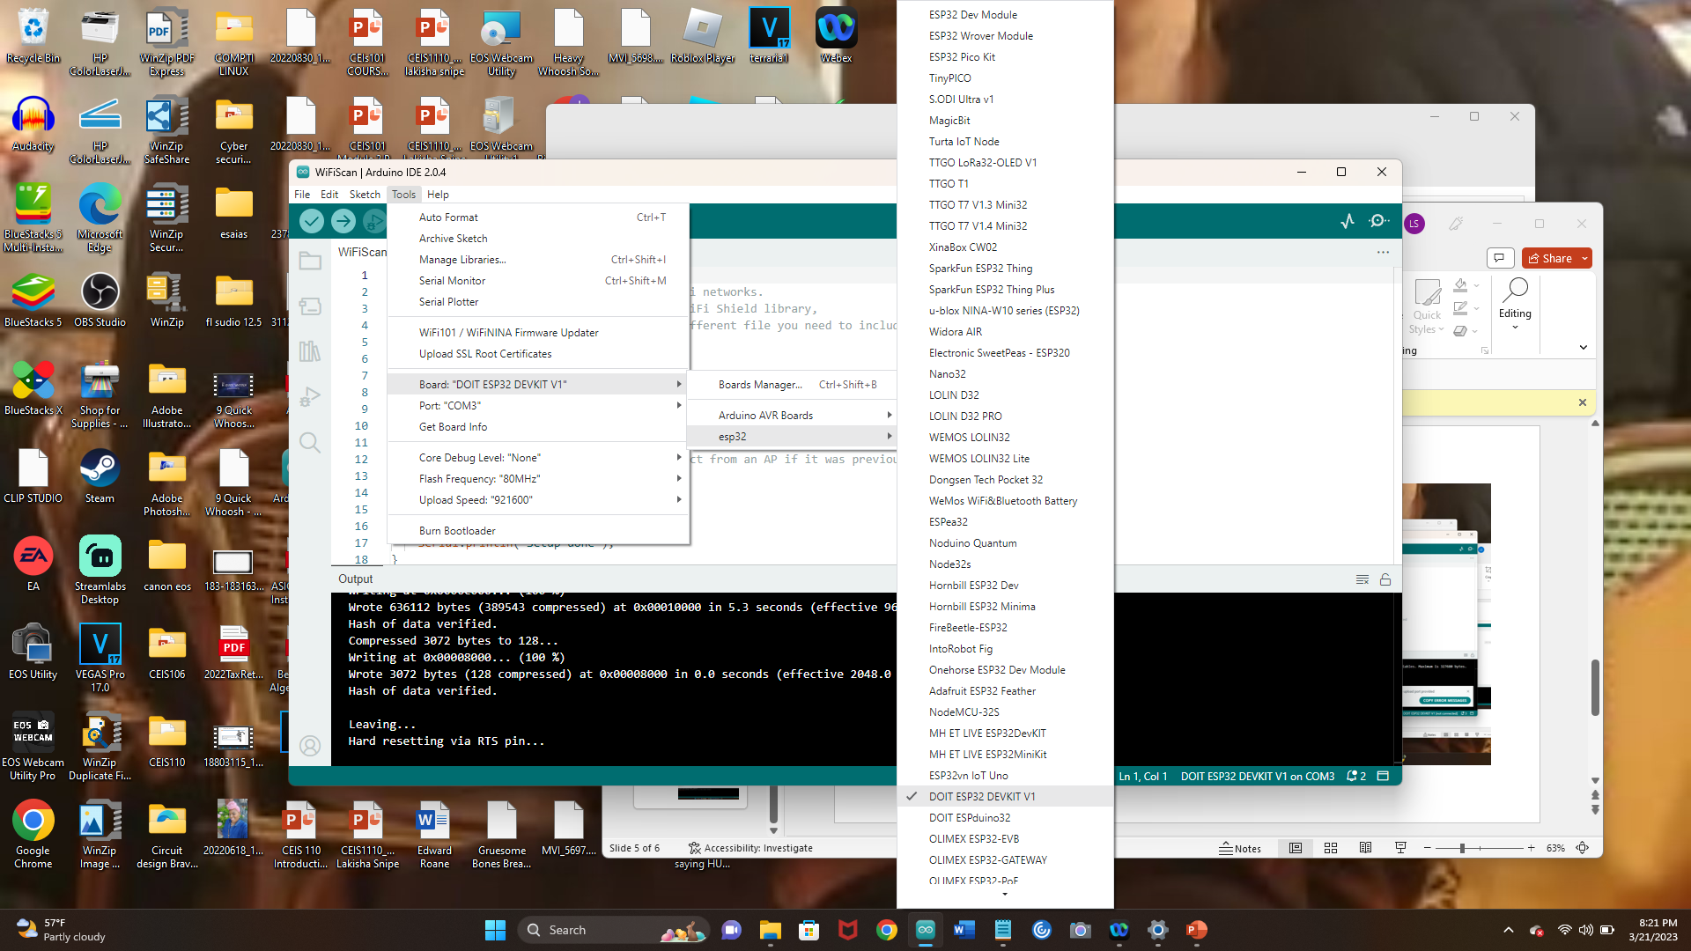
Installation of Arduino IDE
Screenshot of Arduino IDE with Port selected from
Tools menu.

Slide 8
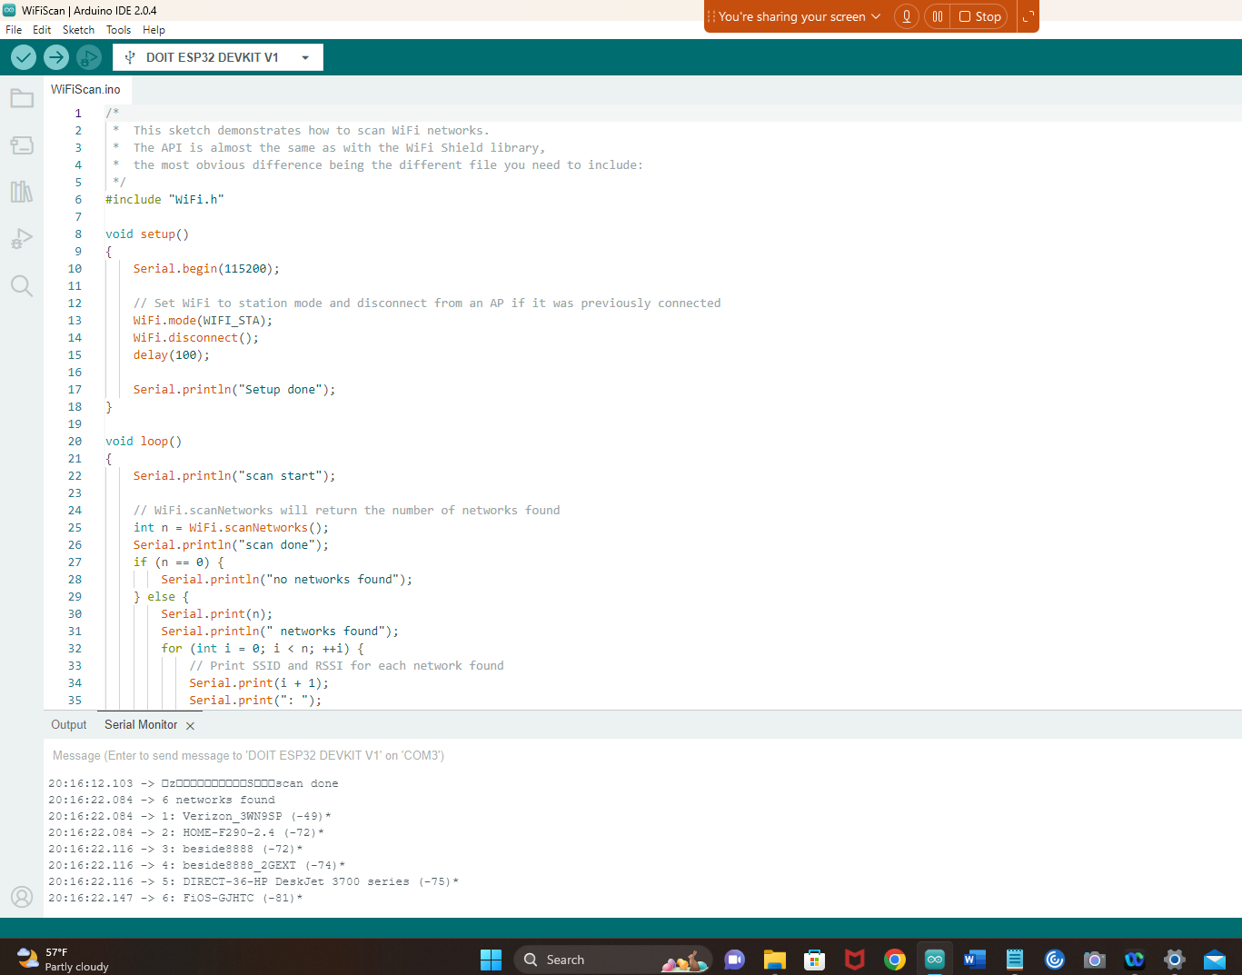
ESP32 WiFi Scan
Screenshot of Serial Monitor in Arduino
IDE showing the available networks

Slide 9
Creating the Traffic Controller

Slide 10
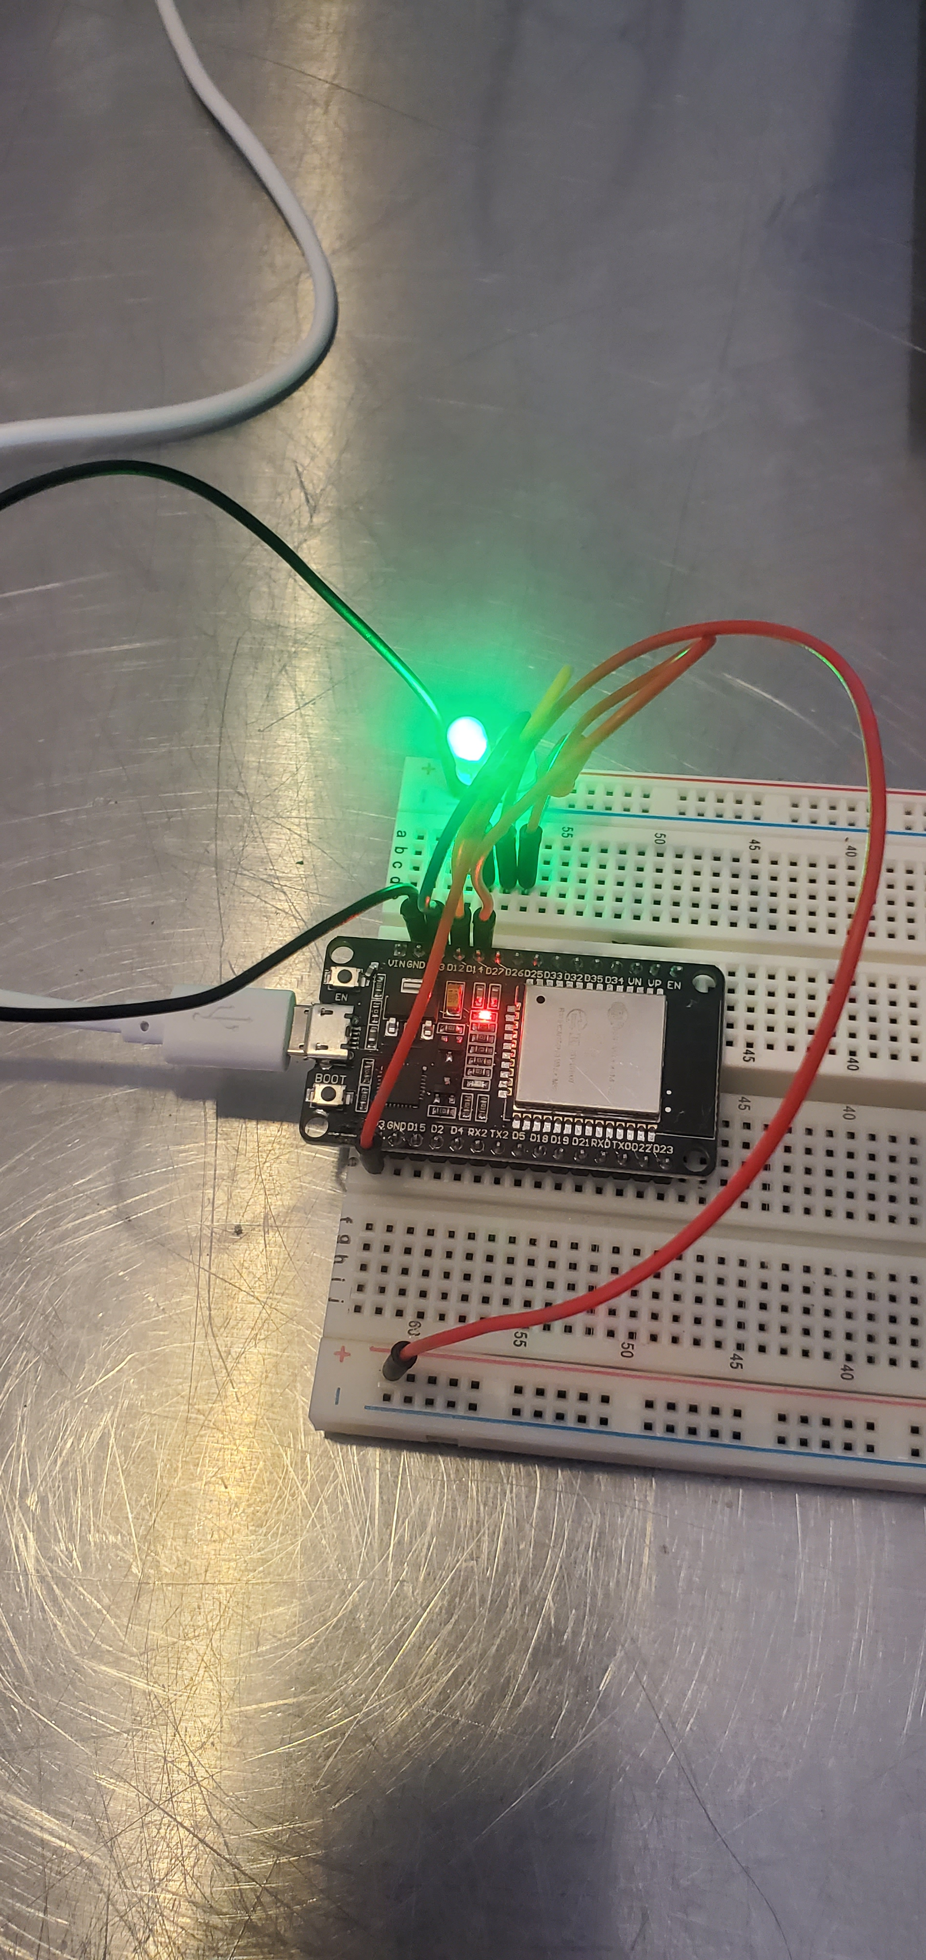
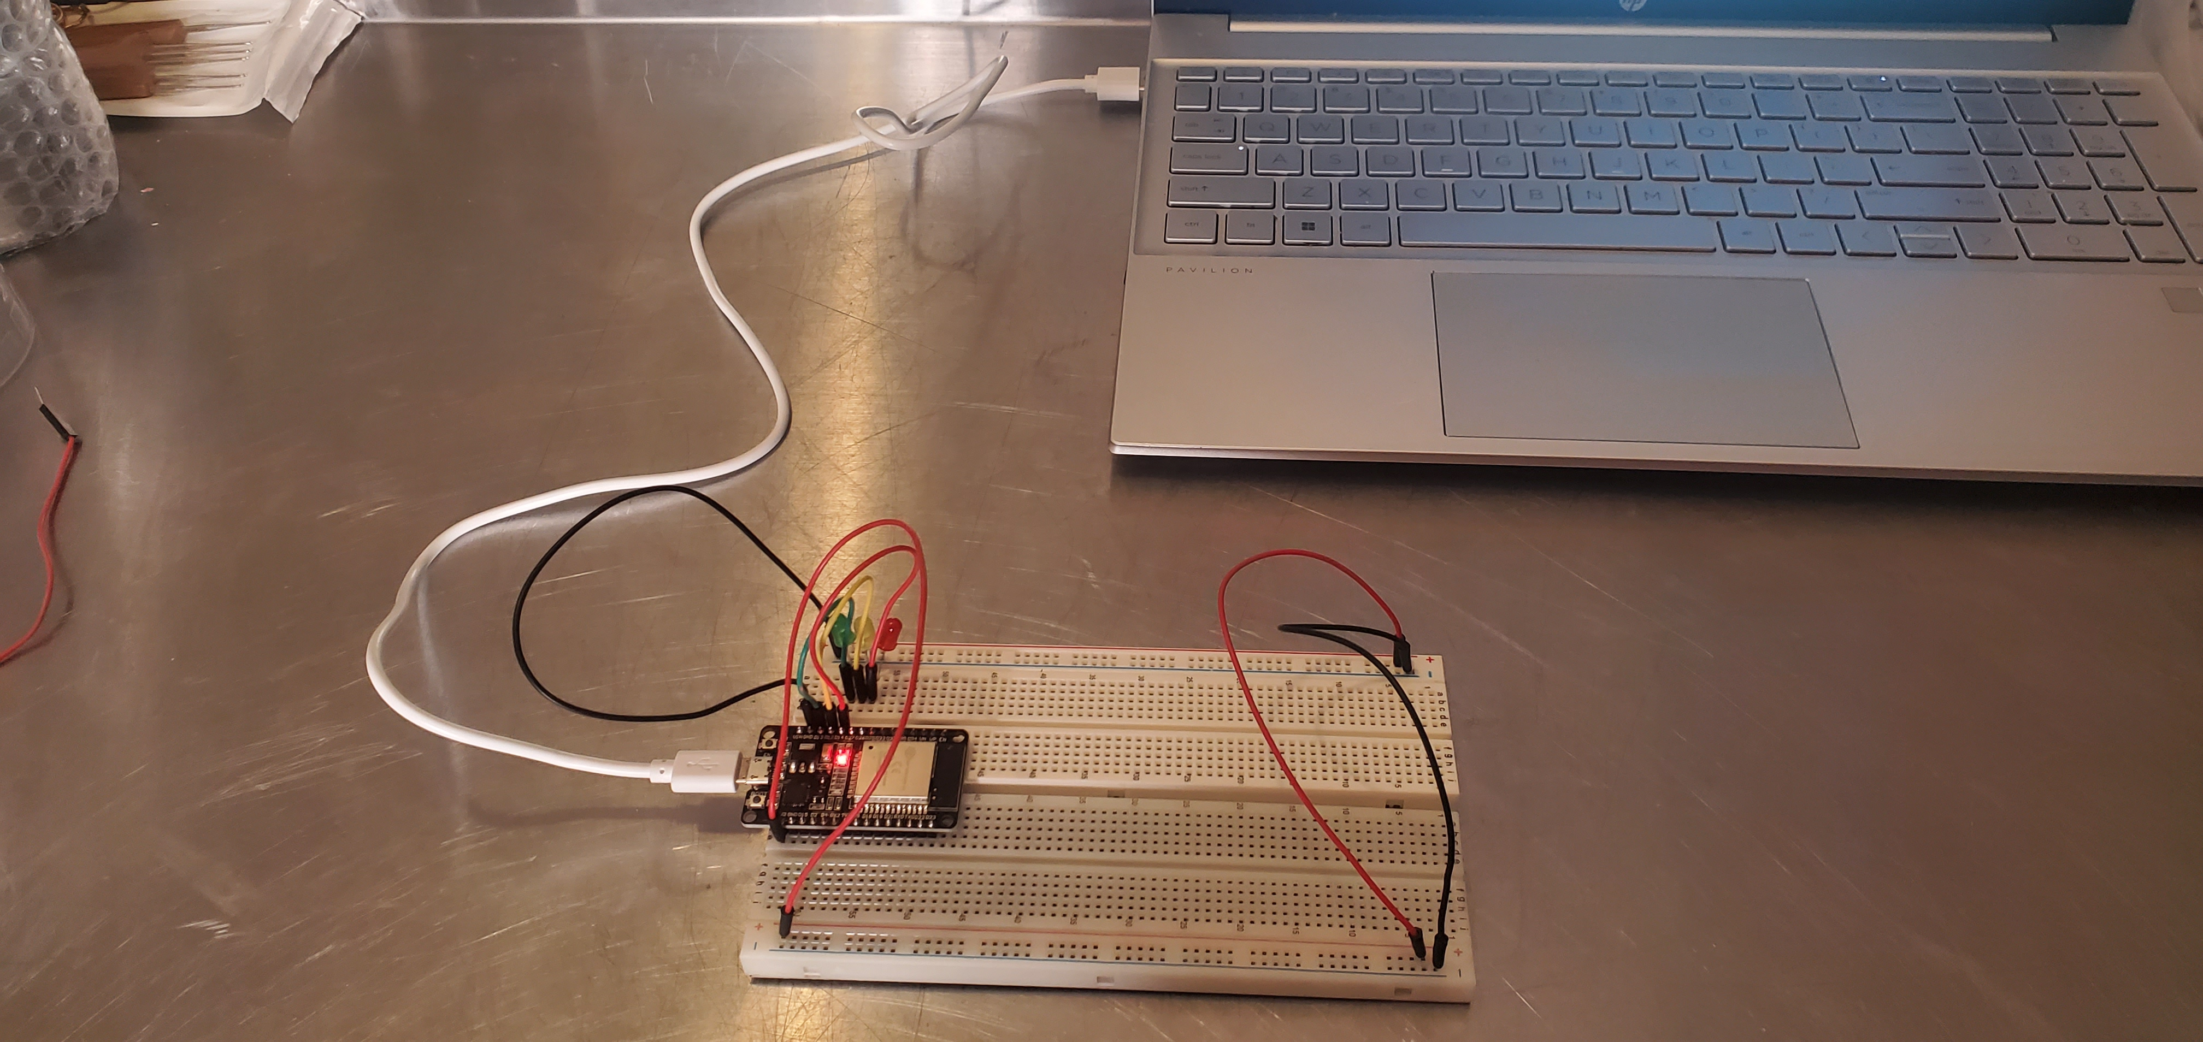
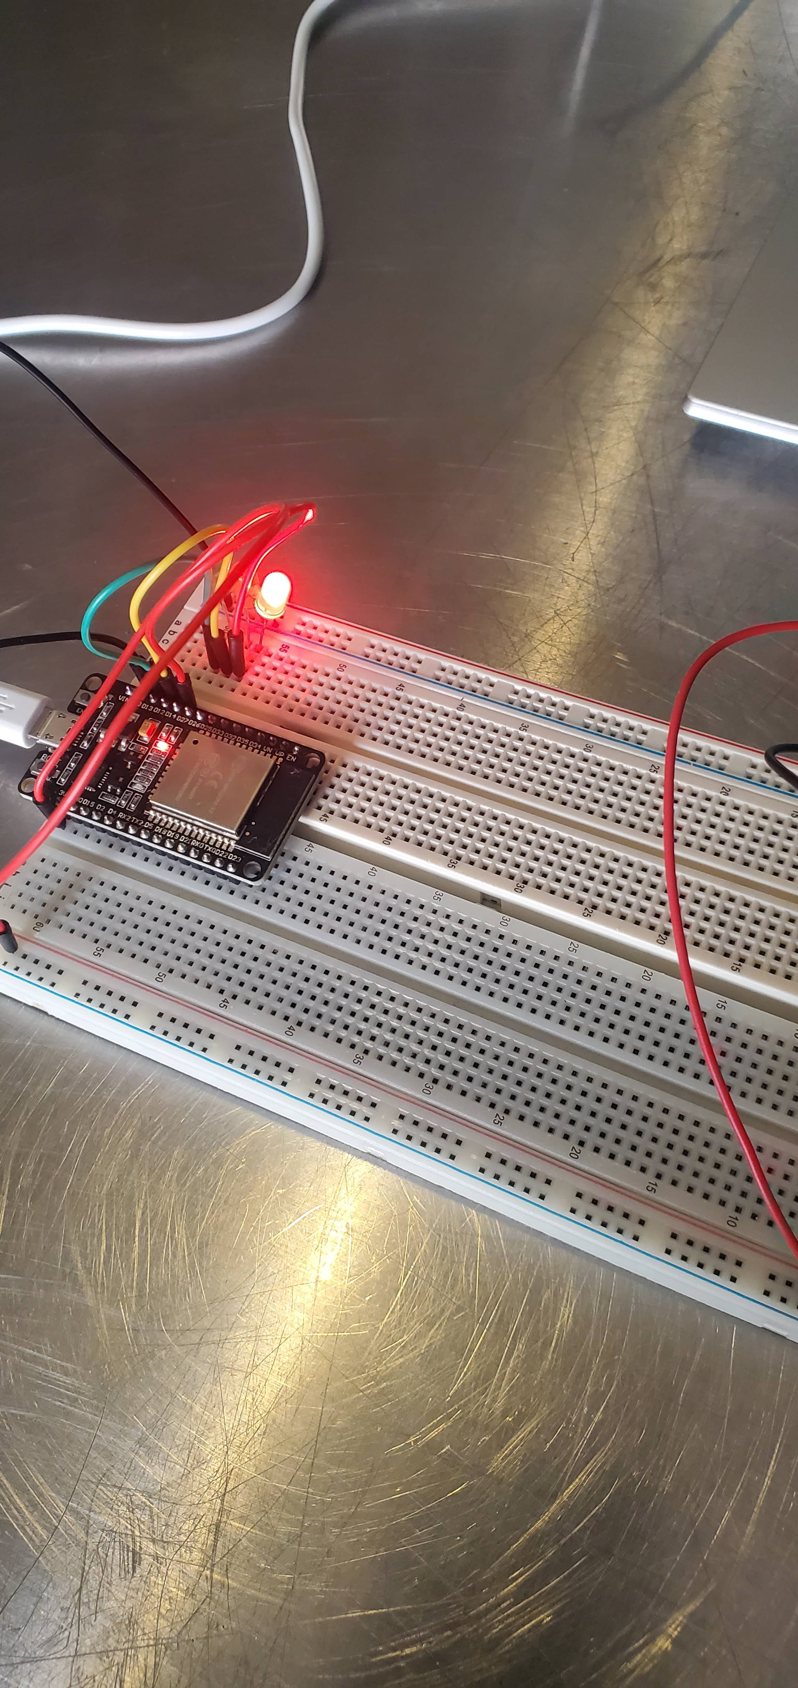
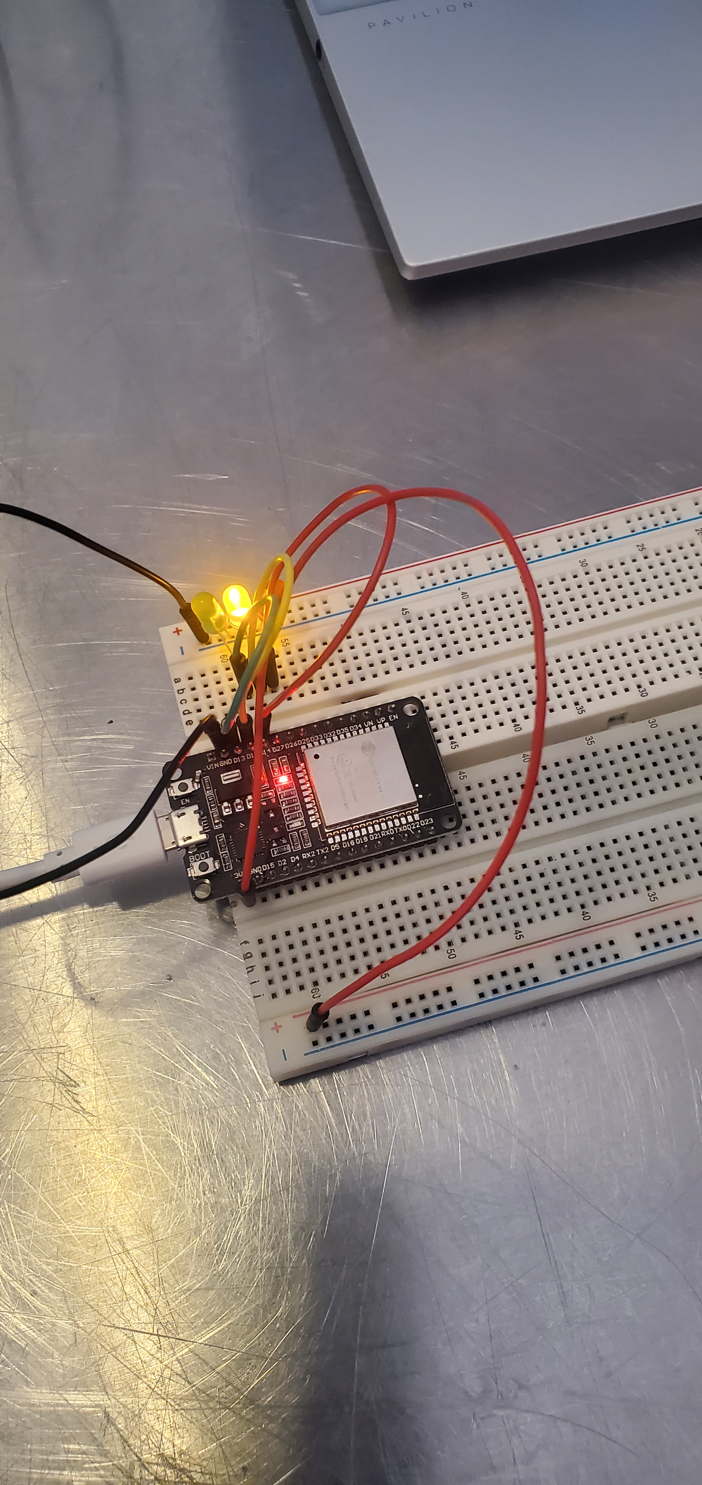
Picture of circuit with working LEDs
ESP 32 Board
Colored LEDs: Red, Yellow and Green
220 Ohm Resistors (optional)
Wires
Breadboard

Slide 11
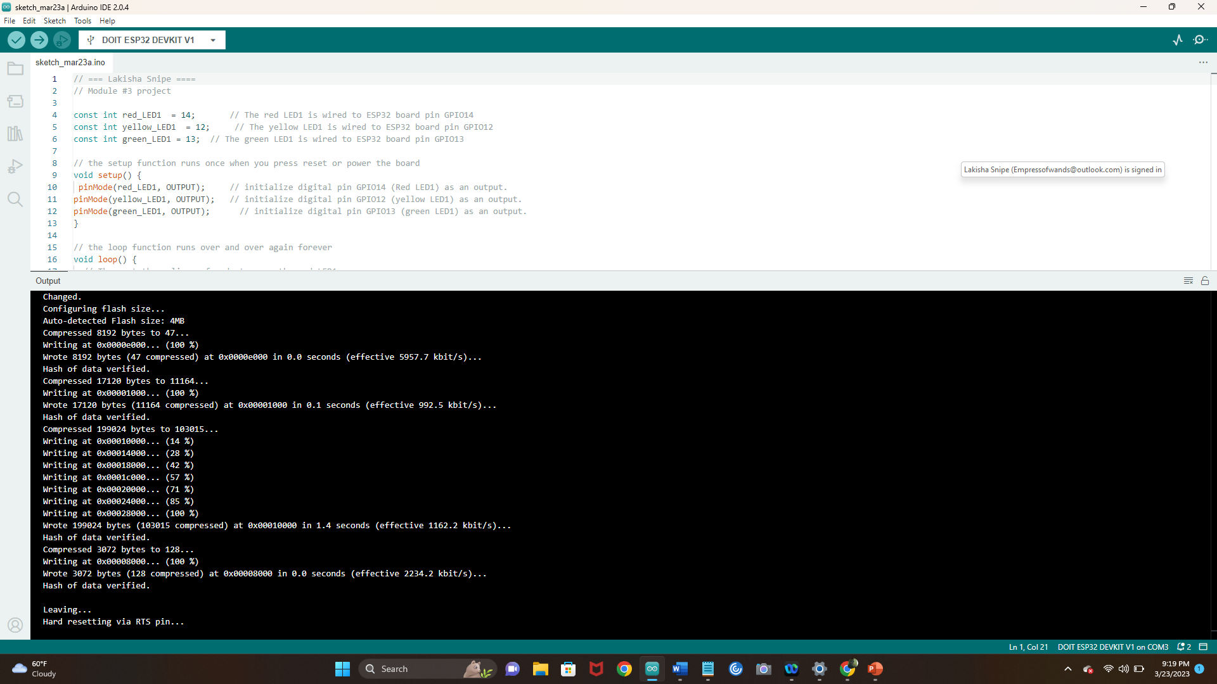
Screenshot of code in Arduino IDE
Screenshot of code in Arduino IDE showing my name in the comment

Slide 12
Creating a multiple traffic light controller

Slide 13
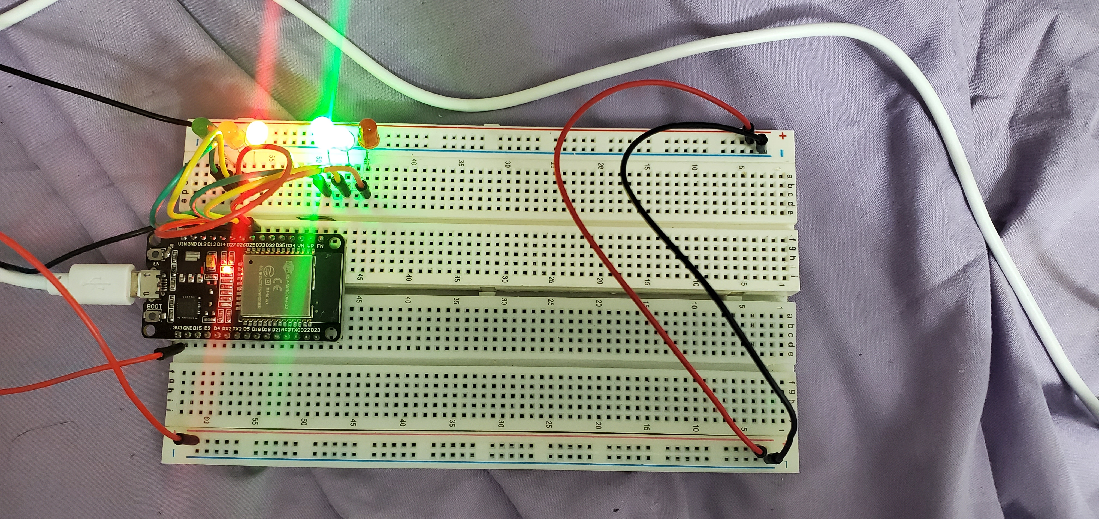
Picture of circuit with working LEDs
ESP 32 Board
Colored LEDs: Red, Yellow and Green (two sets)
220 Ohm Resistors (optional)
Wires
Breadboard

Slide 14
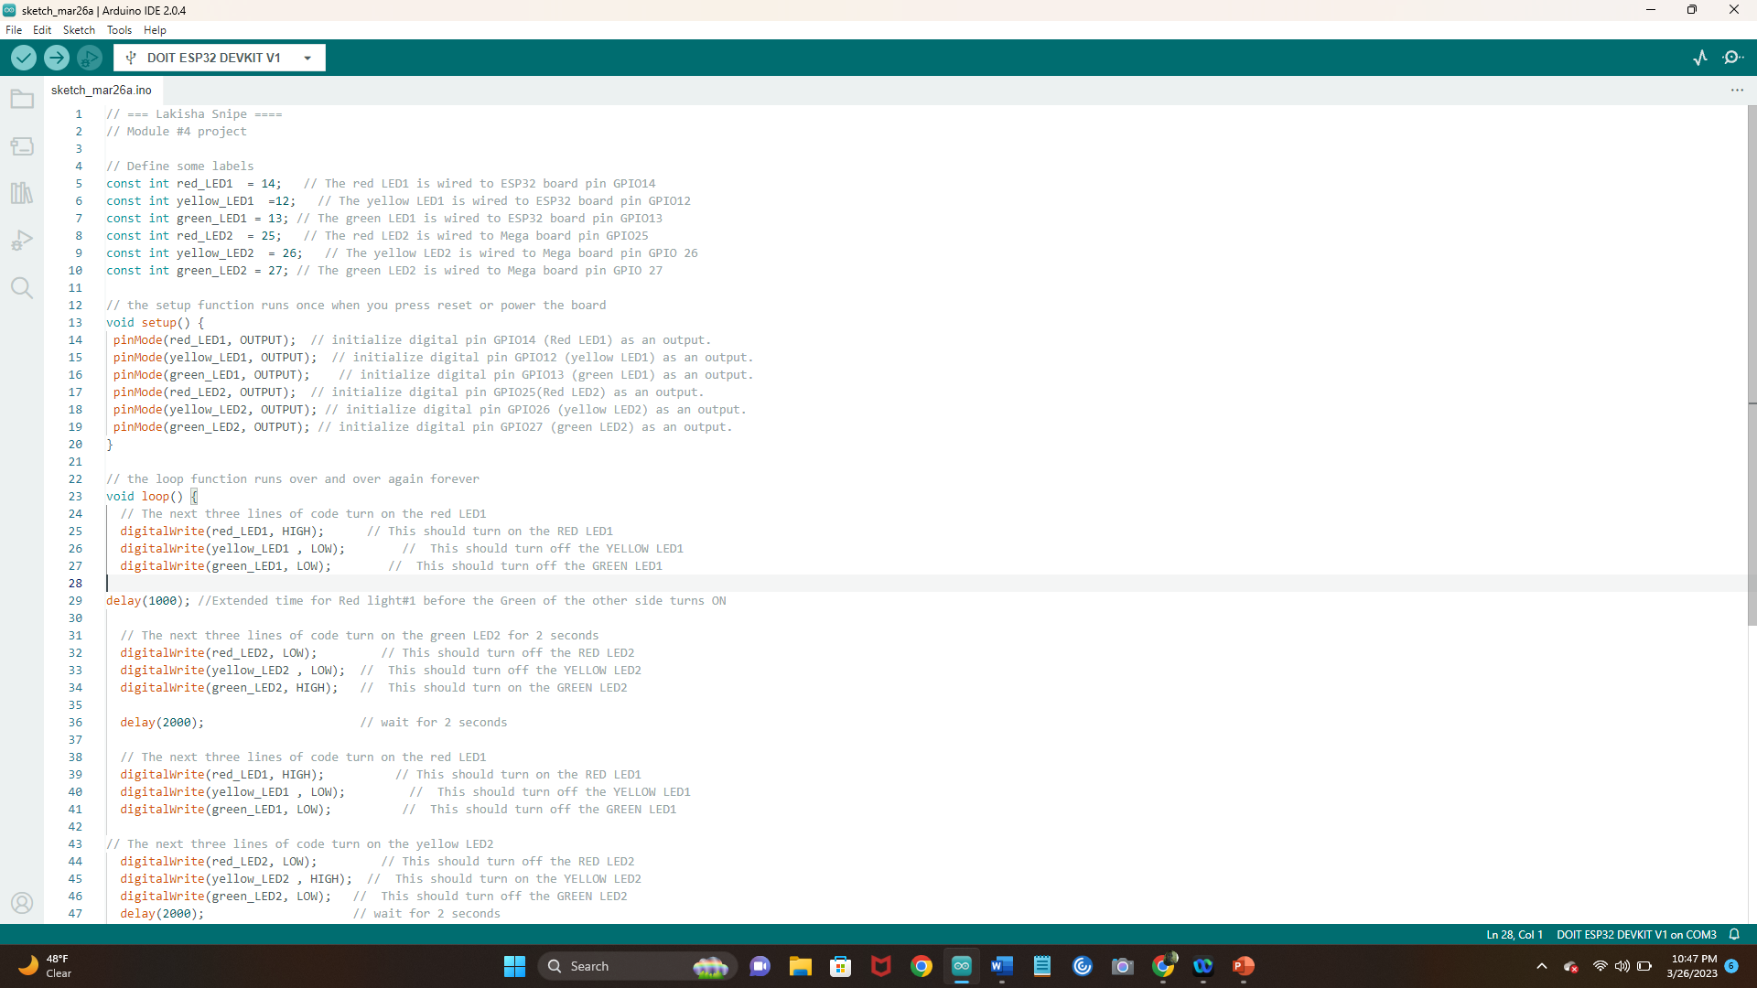
Screenshot of code in Arduino IDE

Slide 15
Creating a multiple traffic light controller with a cross walk

Slide 16
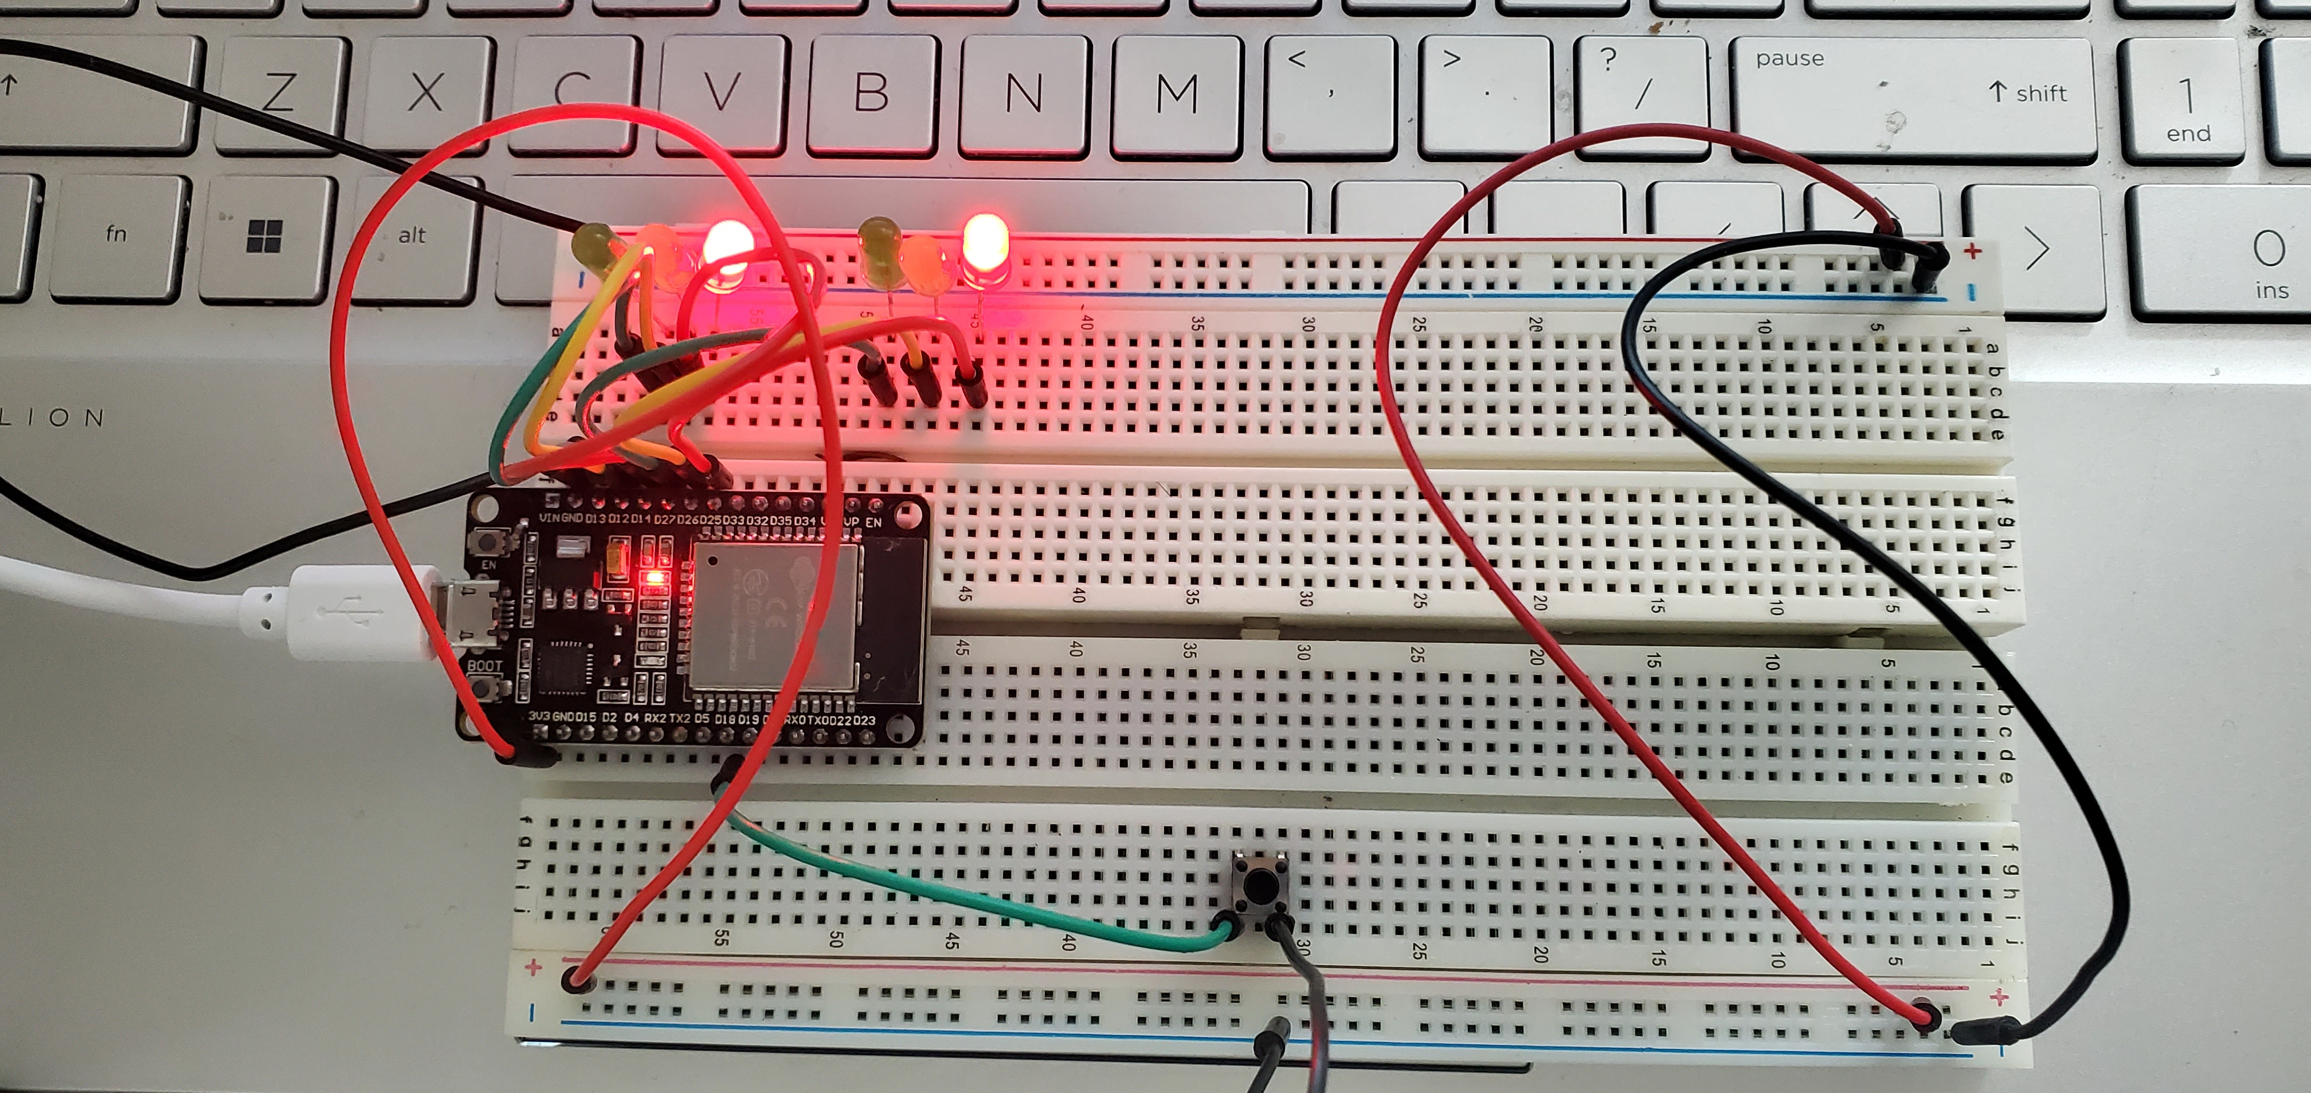
Picture of circuit with working LEDs
ESP 32 Board
Colored LEDs: Red, Yellow and Green (two sets)
220 Ohm Resistors (optional)
Push Button
Wires
Breadboard

Slide 17
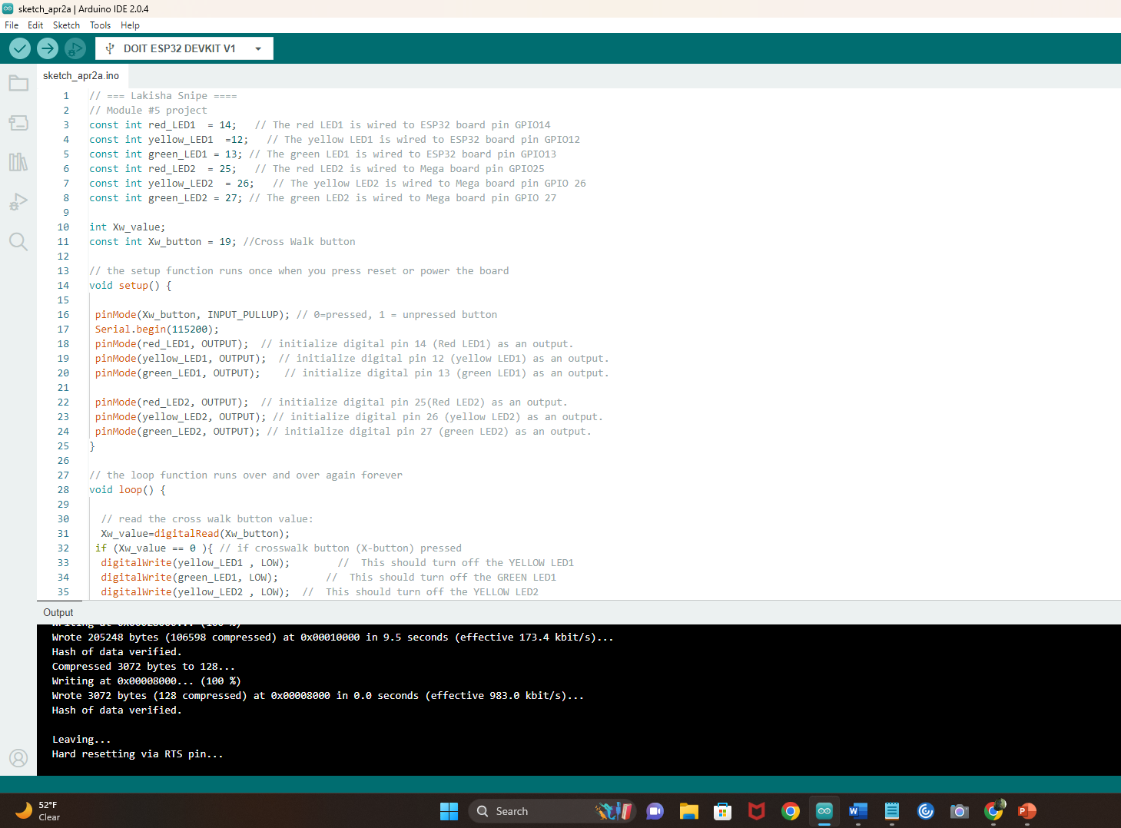
Screenshot of code in Arduino IDE

Slide 18
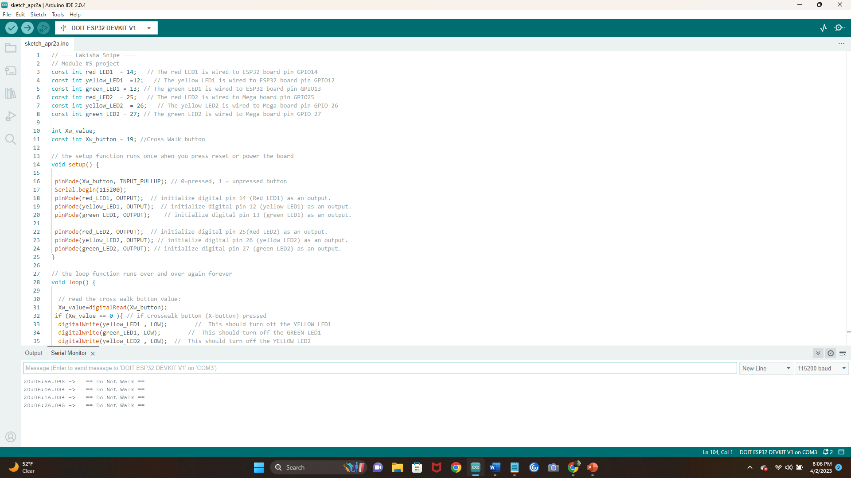
Screenshot of Serial Monitor in Arduino IDE
Screenshot of output in Serial Monitor

Slide 19
Creating a multiple traffic light controller with a cross walk and an emergency buzzer

Slide 20
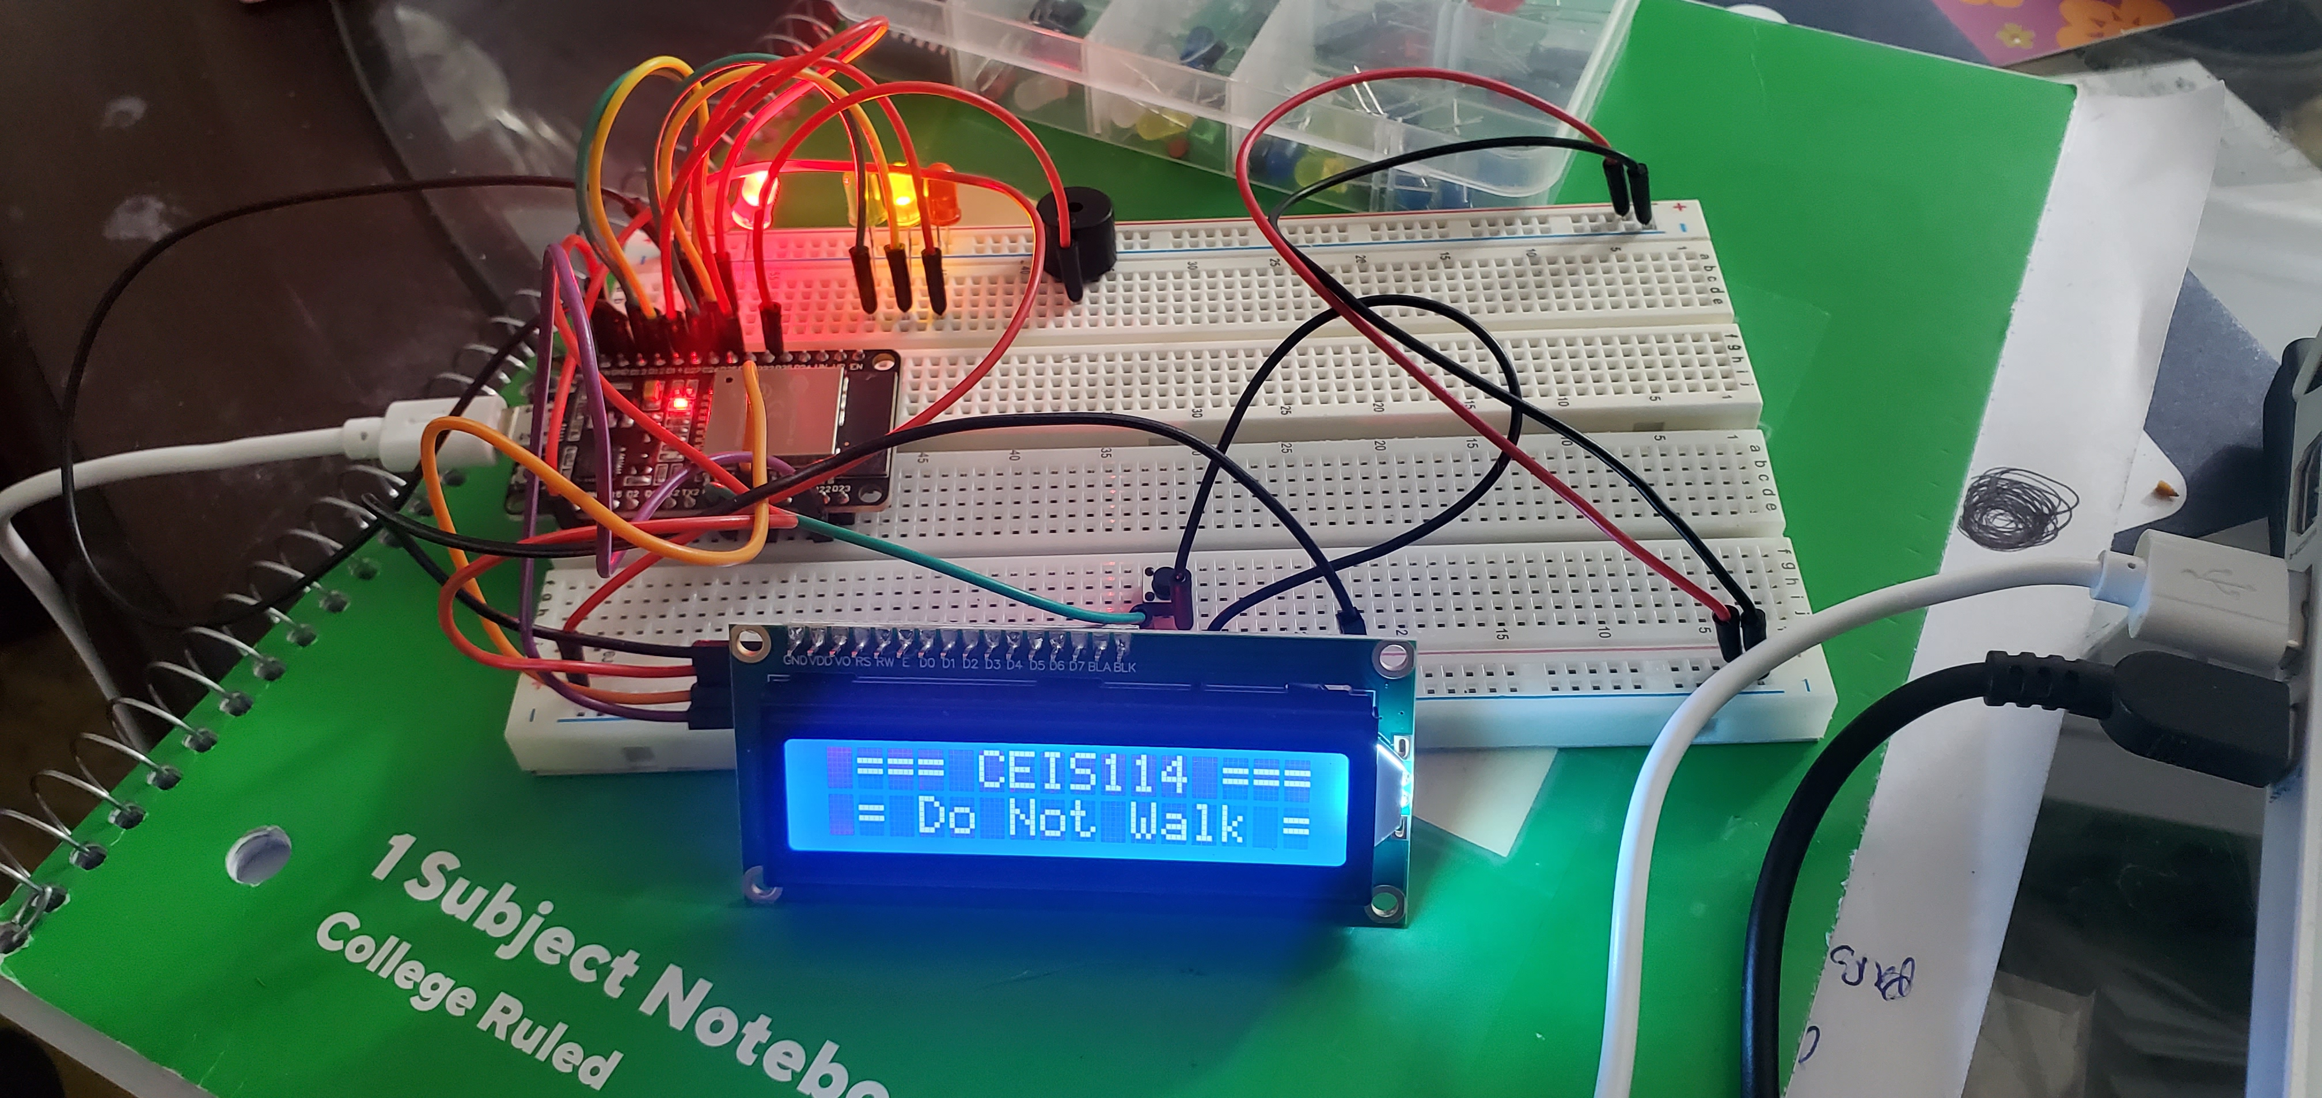
Picture of circuit with working LEDs and LCD display
ESP 32 Board
Colored LEDs: Red, Yellow and Green (two sets)
220 Ohm Resistors (optional)
Push Button
LCD Unit with Message Display
Wires
Breadboard

Slide 21
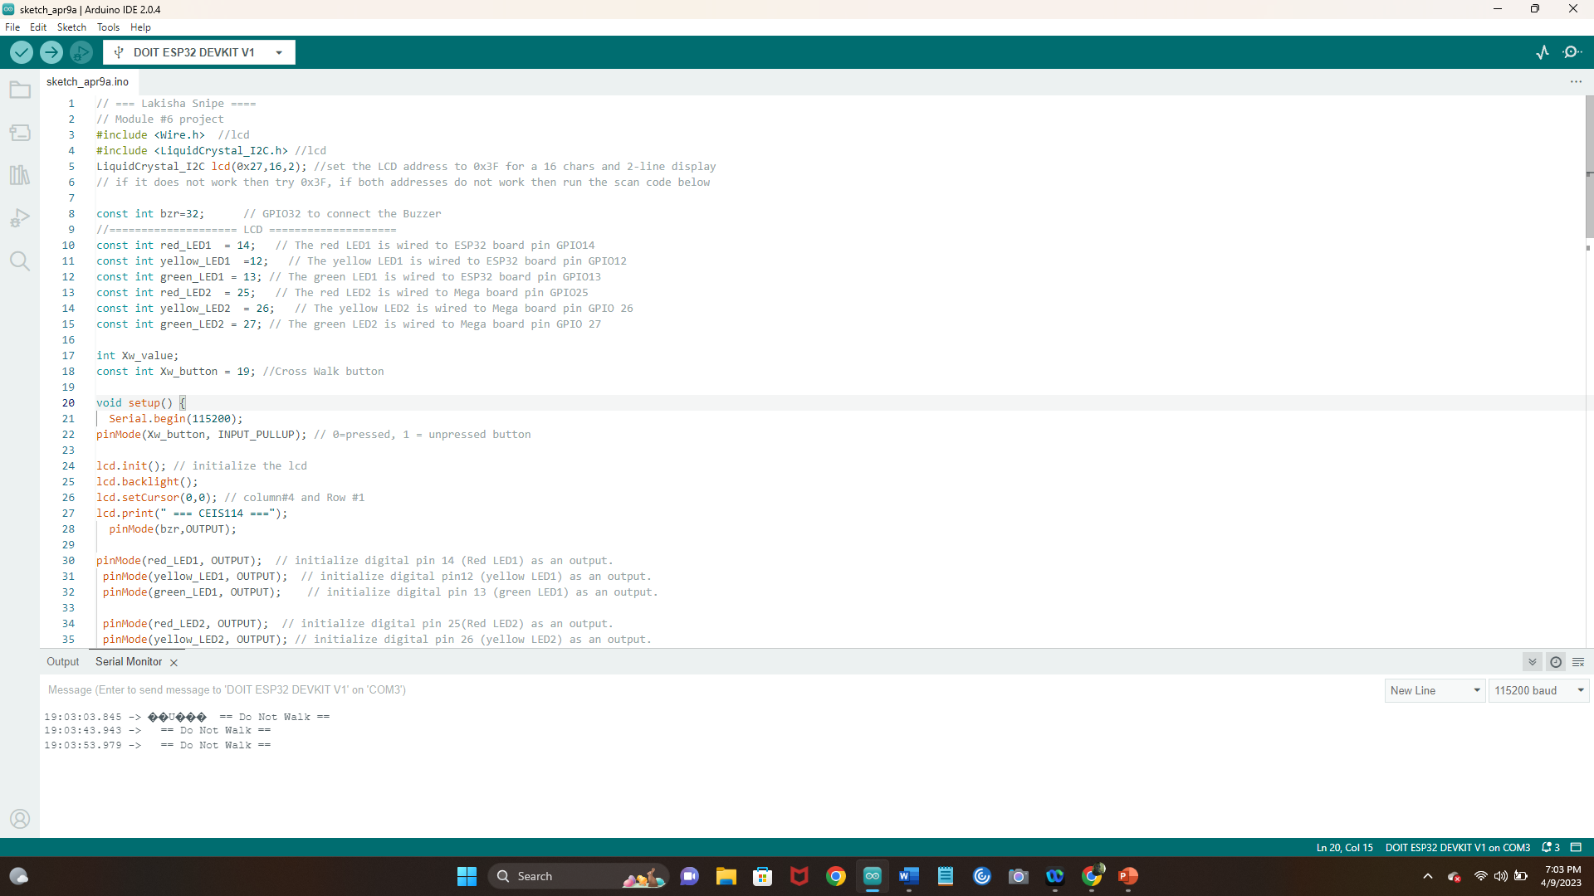
Screenshot of code in Arduino IDE

Slide 22
Screenshot of Serial Monitor in Arduino IDE

Slide 23
Creating a Multiple Traffic Light Controller with a Cross Walk and an Emergency Buzzer with SMART sensor(option 2)

Slide 24
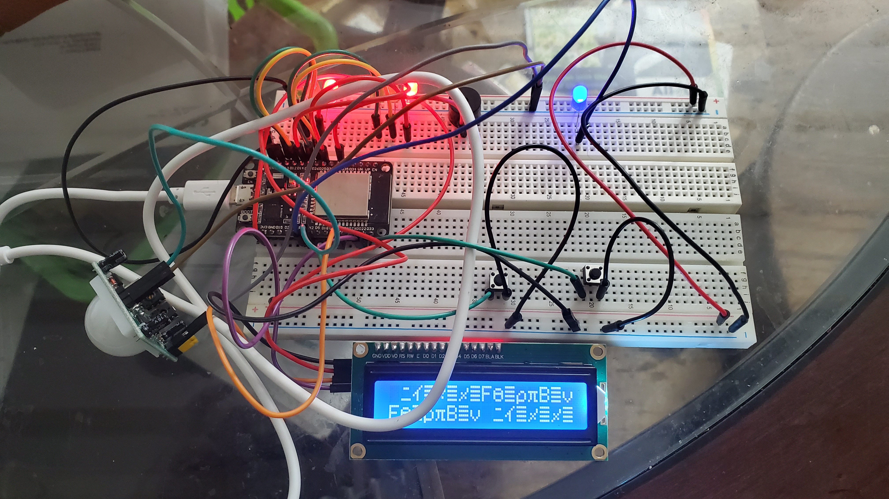
Picture of circuit with working LEDs and LCD display
ESP 32 Board
Colored LEDs: Red, Yellow and Green (two sets)
One Blue LED – Emergency Light
220 Ohm Resistors (optional)
Push Buttons - 2
LCD Unit
Buzzer
PIR Motion Sensor
Router
Wires
Breadboard

Slide 25
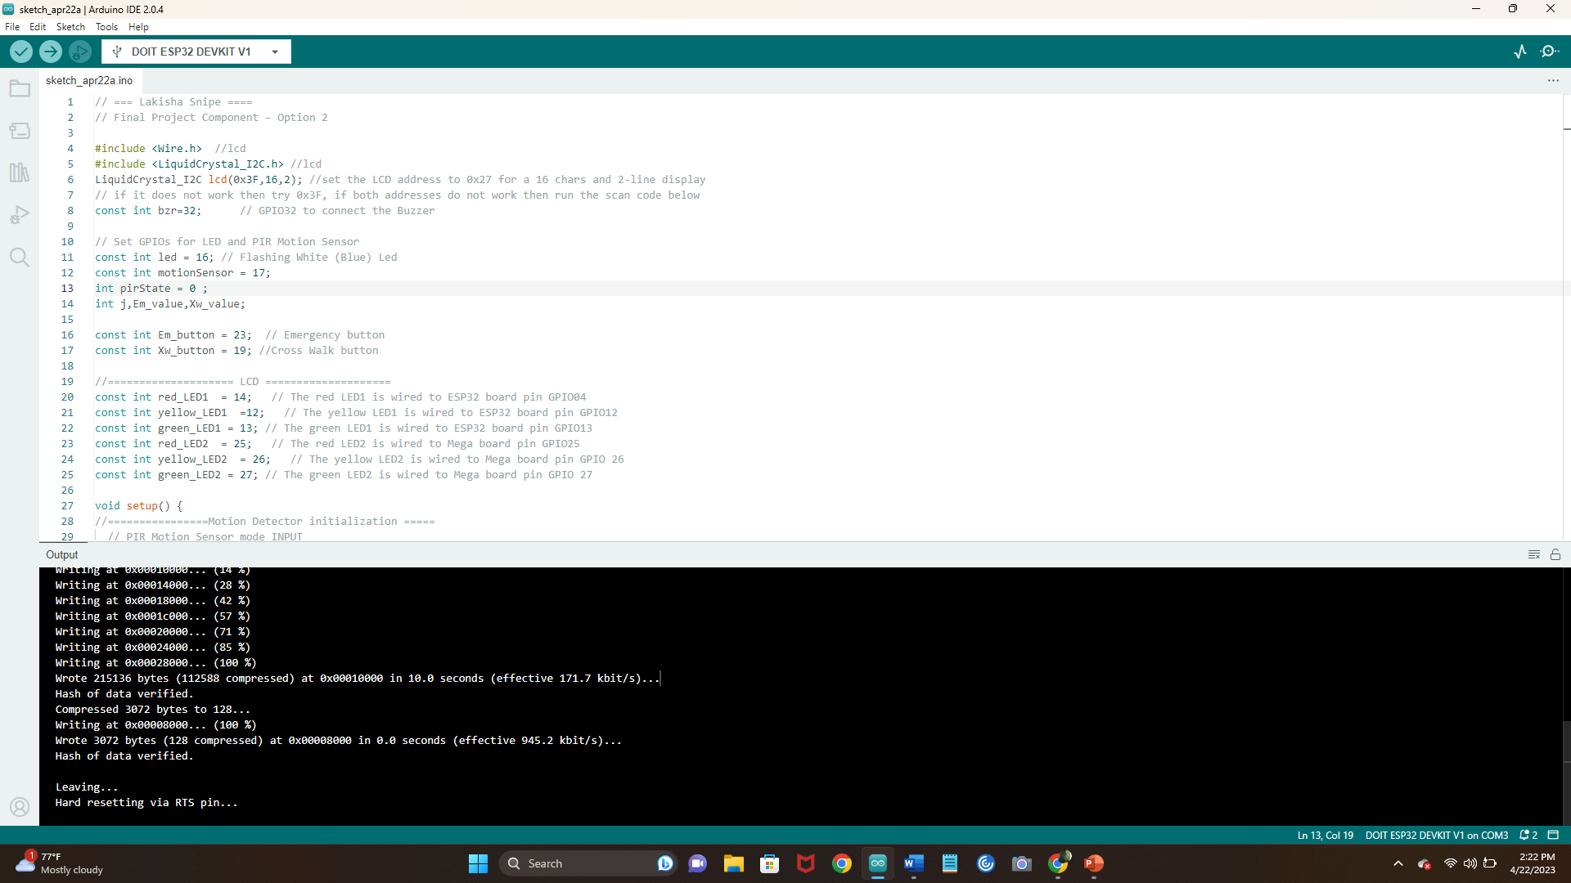
Screenshot of code in Arduino IDE

Slide 26
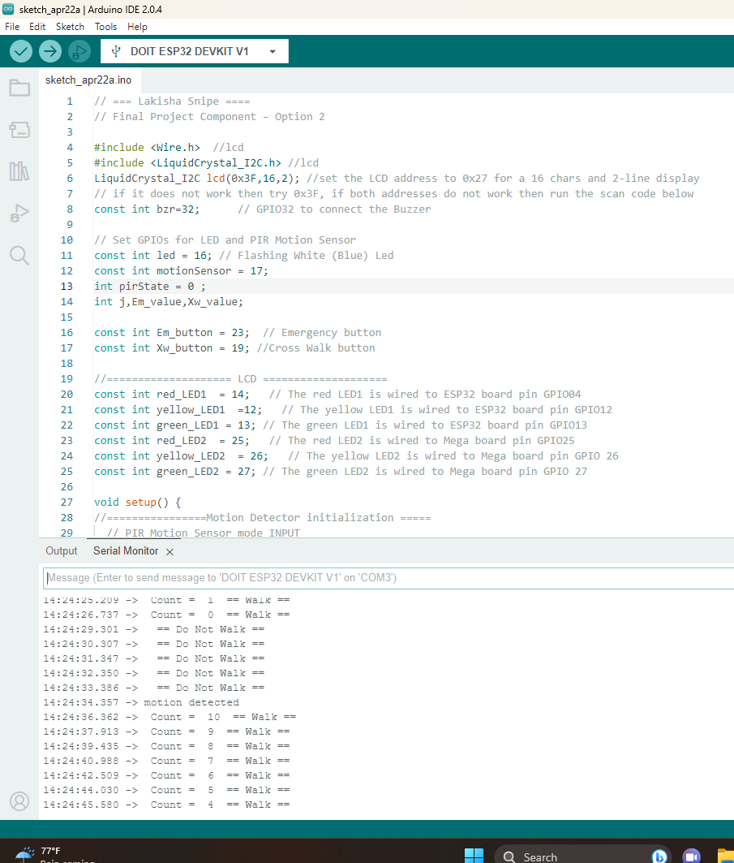
Screenshot of Serial Monitor in Arduino IDE

Slide 27
Student feedback and reflection

Slide 28
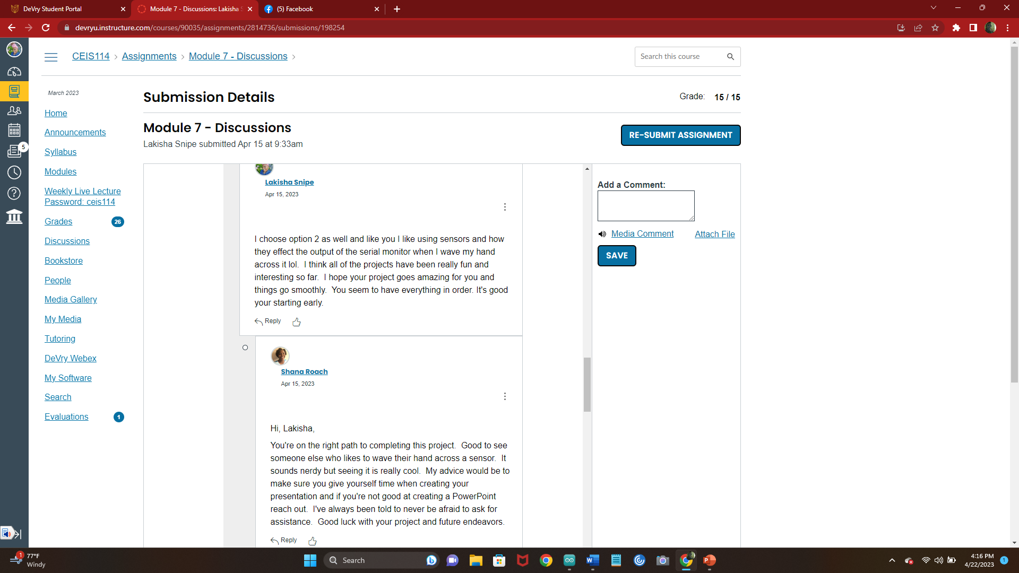
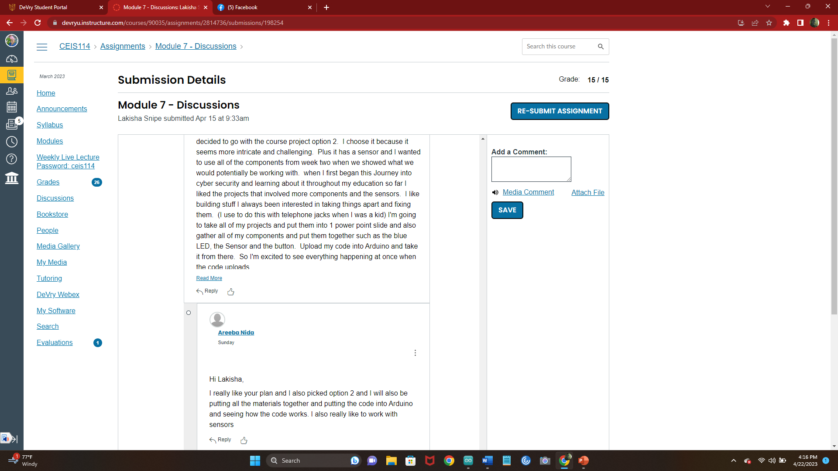

Slide 29
The biggest thing I noticed with working in a group and with feedback from my classmates
is there is really a team effort to be willing to help. I think that is so important because my
journey with my career into cyber security will in my opinion be heavily reliant on being a part of
a team to get things done. It’s refreshing to know that in my line of work I have people around who are
helpful and willing to teach me and I teach them if necessary.

Slide 30
Conclusion, challenges and career skill obtained

Slide 31
In conclusion technology and IOT devices are used everyday.
I for sure look at the digital world with a new perspective and a greater respect for this line of work.
It takes a smart critical thinker to keep companies running, and to keep cities and basically the world running.
Without digital devices we would literally be In the dark. Some of the challenges I faced was honestly work life balance
Including my schooling into the mix. These are real life scenarios that I’m going to be challenged with and knowing how to
Get through the hurdles will definitely help me along my journey in to the IT/Technology/Cyber Security field. There are a lot
of career options to choose from just by learning this one class. I learned how to build a traffic controller I can use these skills
And take Them anywhere from being a traffic controller engineer(of course with more study and experience) I could become
a digital product tester for quality and control. I know what to look for and the steps to test out a design before it rolls out.
This is a well rounded course which gives me options for a well rounded career that honestly would help me live a more
Comfortable life.

